Slide 1
Web development basics
OOP in JS

Slide 2
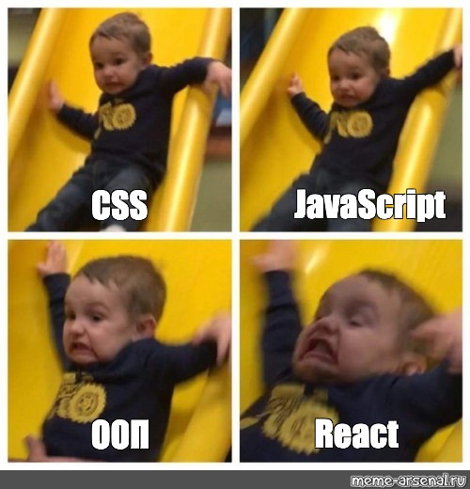
Introduction to OOP in JavaScript
OOP in JavaScript stands for Object-Oriented Programming. It's a programming paradigm that focuses on organizing code into objects that represent real-world entities, making the code more readable, reusable and scalable.
By using OOP in JavaScript, developers can build more complex and organized codebases, improving their productivity and the quality of the code they produce.

Slide 3
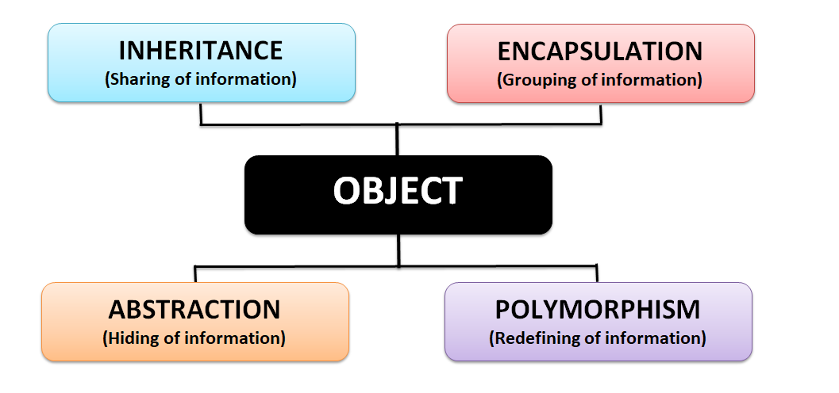
The 4 Pillars of OOP programming
Abstraction: The ability to hide implementation details and present a simplified interface to the user.
Encapsulation: Wrapping code and data into a single unit, making it easier to maintain and manage.
Inheritance: The ability to extend and reuse code, reducing duplicated effort and improving code maintainability.
Polymorphism: The ability to write code that can operate on multiple types of objects, making it more flexible and adaptable.

Slide 4
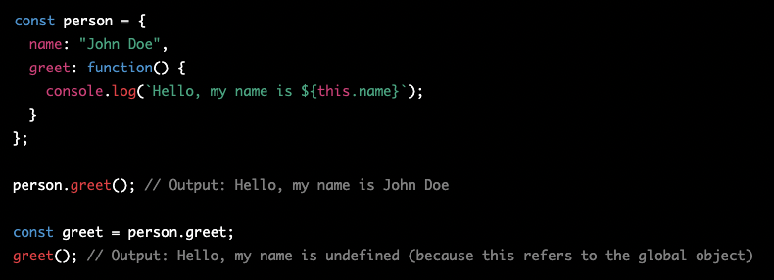
Explaining “this”
ES5 Functions: In ES5, the value of this is determined by how the function is called. If a function is called as a method of an object, this refers to the object. If a function is called as a standalone function, this refers to the global object (i.e., window in the browser or global in Node.js).

Slide 5
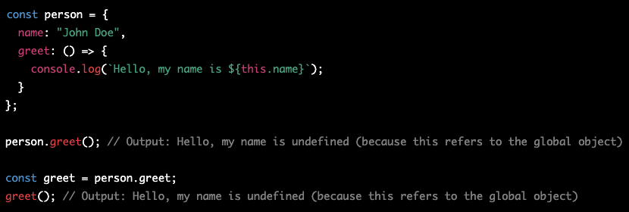
Explaining “this” 2
2) ES6 Arrow Functions: In ES6, arrow functions have a different this binding behavior than traditional functions. The value of this inside an arrow function is lexically scoped, meaning it takes the value of this from its surrounding context. This means that the value of this inside an arrow function is not affected by how the function is called.

Slide 6
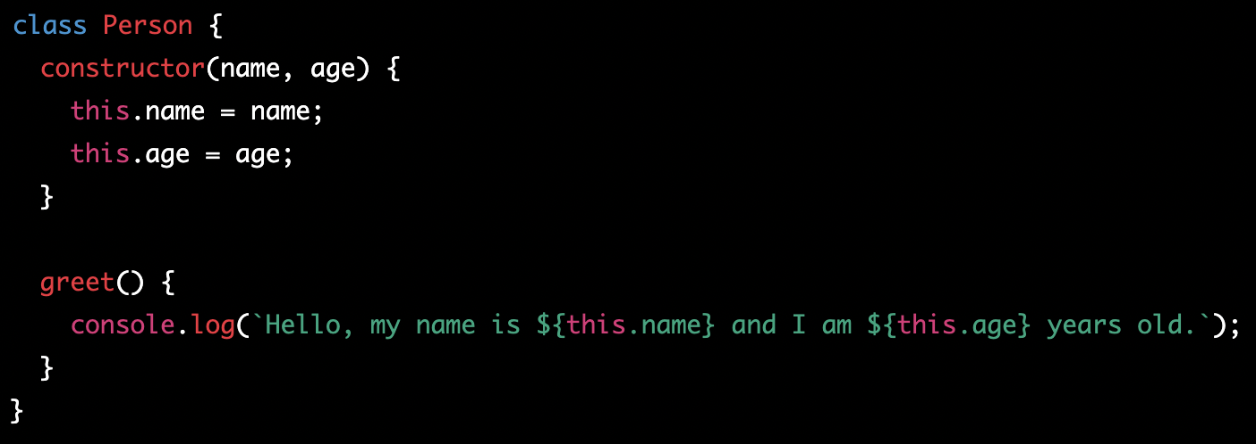
Defining Classes in JavaScript
Classes in JavaScript can be defined using a class syntax introduced in ECMAScript 6 or using a constructor function. Example of defining class using class syntax:

Slide 7
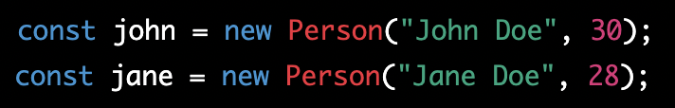
Creating Objects from Classes, Accessing Properties and Methods
Once a class is defined, you can create objects from it using the new keyword. Example:
Accessing Properties and Methods: You can access the properties and methods of objects created from a class using the dot notation.

Slide 8
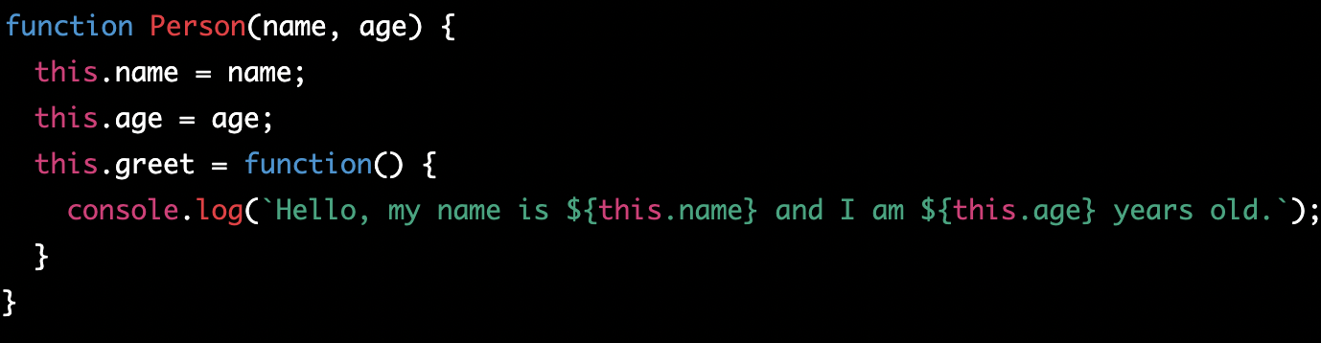
Constructor Functions
A constructor function is a special type of function that is used to create and initialize objects. The constructor function is automatically called when an object is created from a class or when the new keyword is used to create an instance of an object.

Slide 9
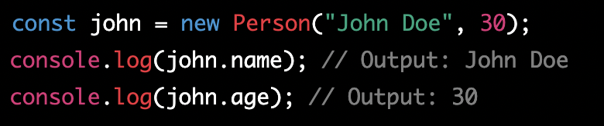
Setting Properties with the Constructor Function
The constructor function can be used to set properties on the newly created object. In the example above, name and age are properties that are set when an object is created from the Person constructor function. In this example, an object john is created from the Person constructor function and its properties name and age are set to "John Doe" and 30 respectively. These properties can be accessed using the dot notation.

Slide 10
Classwork for basic class usage
Create a Student class with a constructor that takes two parameters: name and grade.
Create properties for name and grade in the class and set them using the constructor.
Create a method displayInfo in the class that logs "Name: [name], Grade: [grade]" to the console.
Create another method addGrade in the class that takes a parameter value and adds it to the grade property.

Slide 11
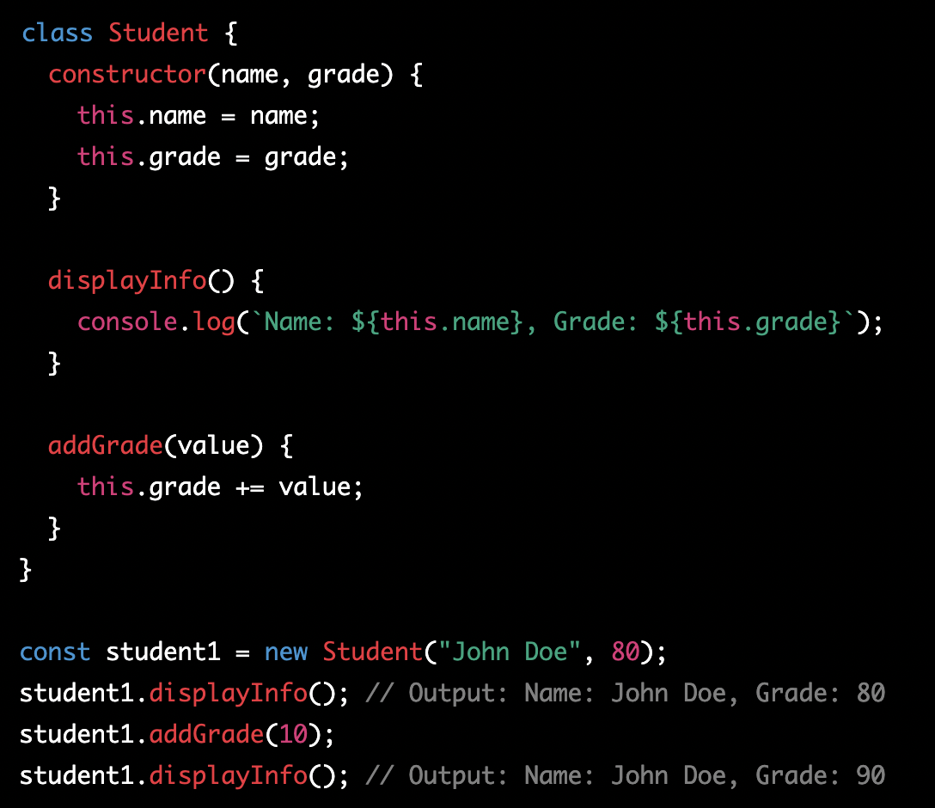
Classwork for basic class usage - solution

Slide 12
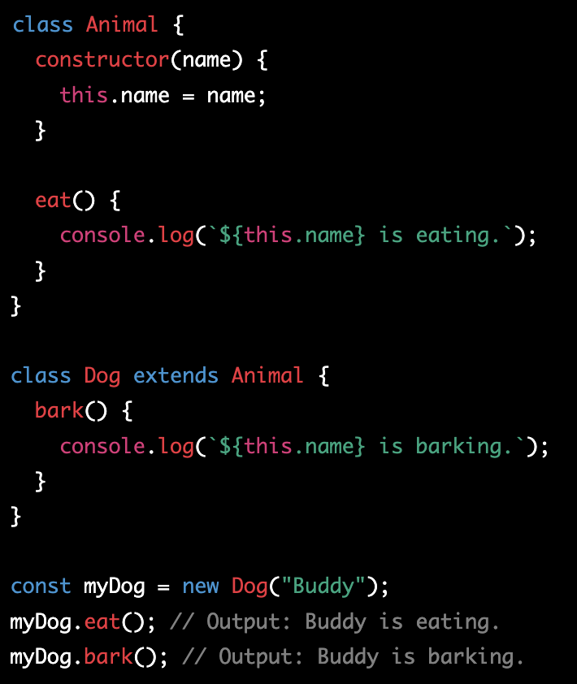
What is Inheritance
1) Inheritance is a concept in Object-Oriented Programming (OOP) that allows an object to inherit properties and behavior from its parent object. This means that a child object can access and use all of the properties and methods of its parent object. Inheritance is a way to reuse code and prevent duplication of code.

Slide 13
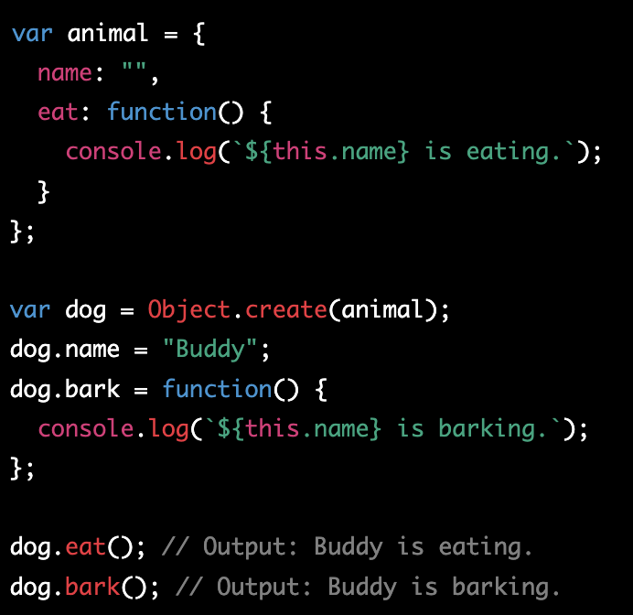
Implementing Inheritance in JavaScript
2) In JavaScript, inheritance is implemented using the prototype object of an object. A child object can inherit properties and methods from its parent object by setting its prototype to be the parent object.

Slide 14
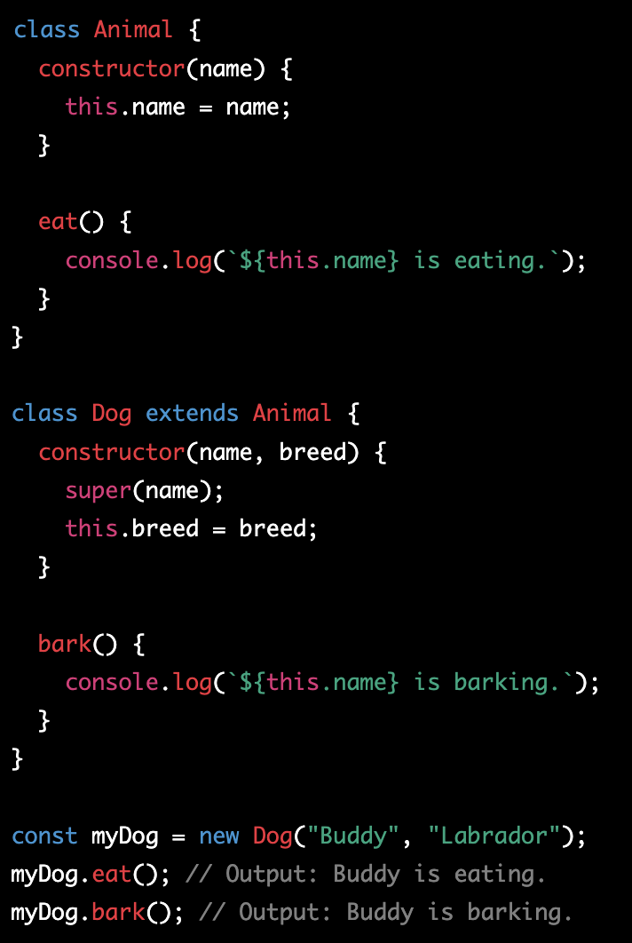
The extends Keyword
3) The extends keyword is a convenient way to implement inheritance in ECMAScript 6 (ES6) and later. The extends keyword is used to specify that one class should inherit from another class.

Slide 15
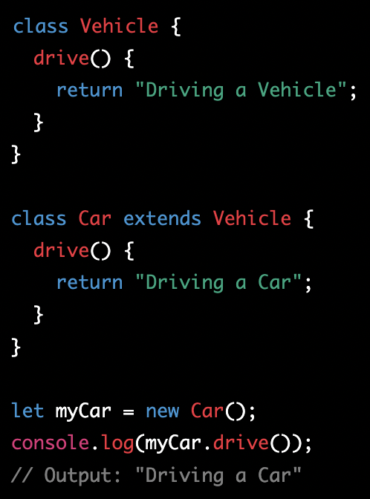
Overriding Methods
4) Overriding Methods in JavaScript: Overriding methods refer to a process in OOP where a subclass provides its own implementation of a method that is already defined in its parent class. This allows the subclass to inherit properties and methods from its parent class, but still provide its own custom implementation of specific methods.

Slide 16
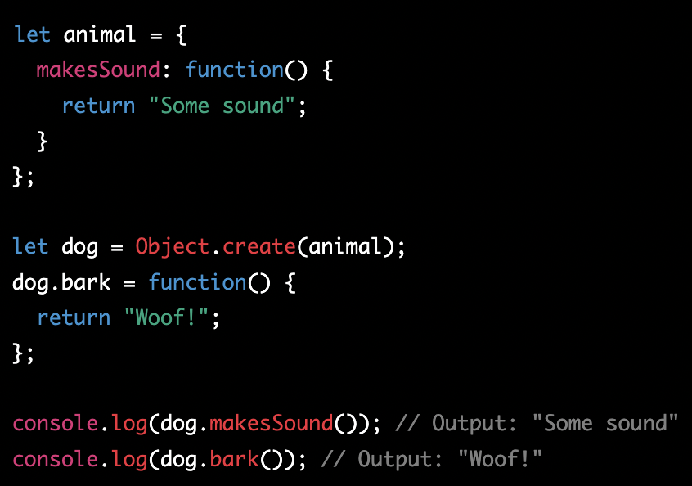
What is Prototype-Based Inheritance
1) Prototype-based inheritance is a way of implementing inheritance in JavaScript where objects can inherit properties and methods from other objects. Instead of using classes to define objects and their relationships, objects can inherit from other objects directly through the use of prototypes.

Slide 17
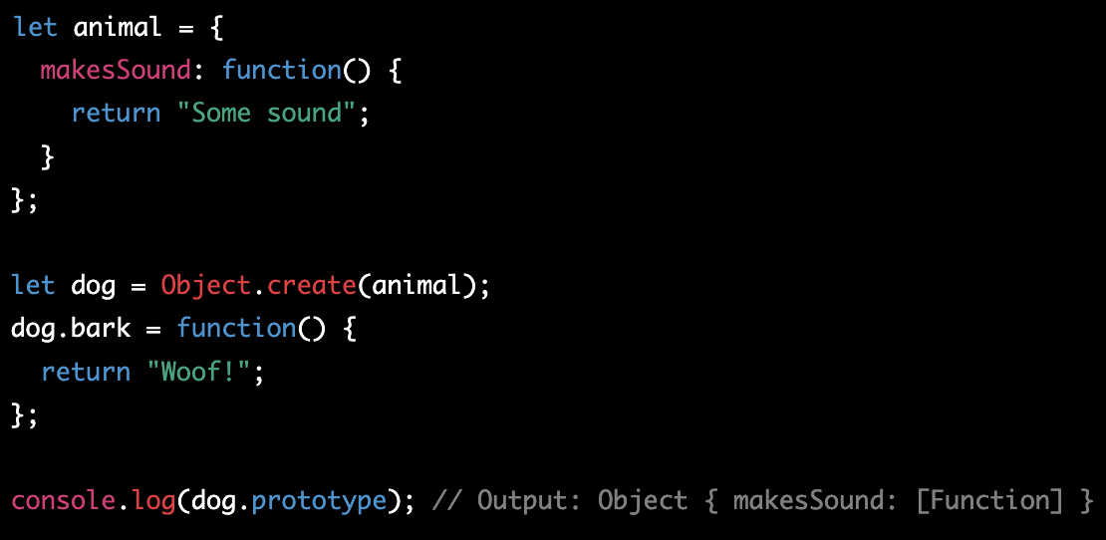
The prototype Property
2) Every object in JavaScript has a special property called prototype that points to the object it inherits from. This property is used to create the prototype chain that determines the inheritance hierarchy of objects in JavaScript.

Slide 18
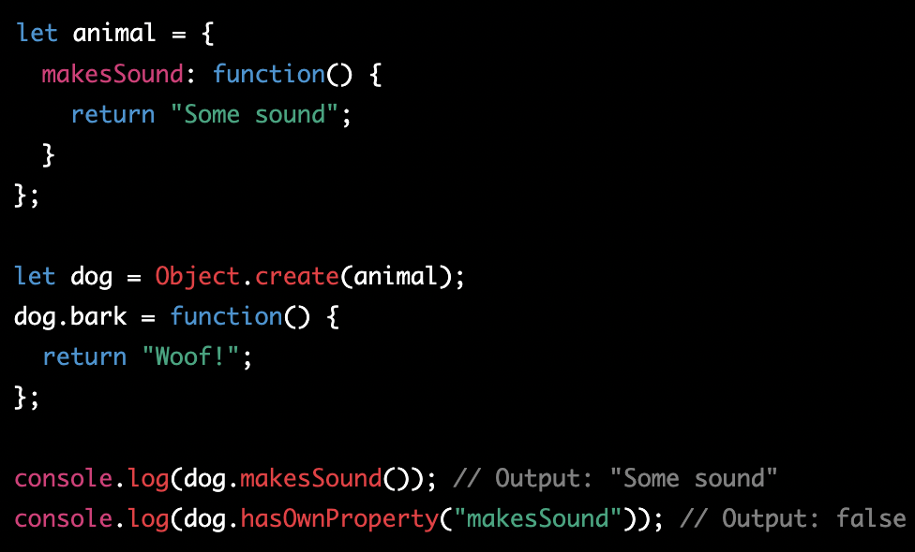
Understanding the Prototype Chain
3) The prototype chain is a chain of objects that are linked to each other through the prototype property. When an object is asked for a property or method that it doesn't have, it will check its prototype, and so on, until it finds what it's looking for or until there are no more prototypes to check.

Slide 19
Classwork - extending and inheritance
Create a class called "Vehicle" with properties "make" and "model".
Create a class called "Car" that extends "Vehicle" and adds a property called "doors".
Create a Car object and print the "make", "model" and "doors" properties.

Slide 20
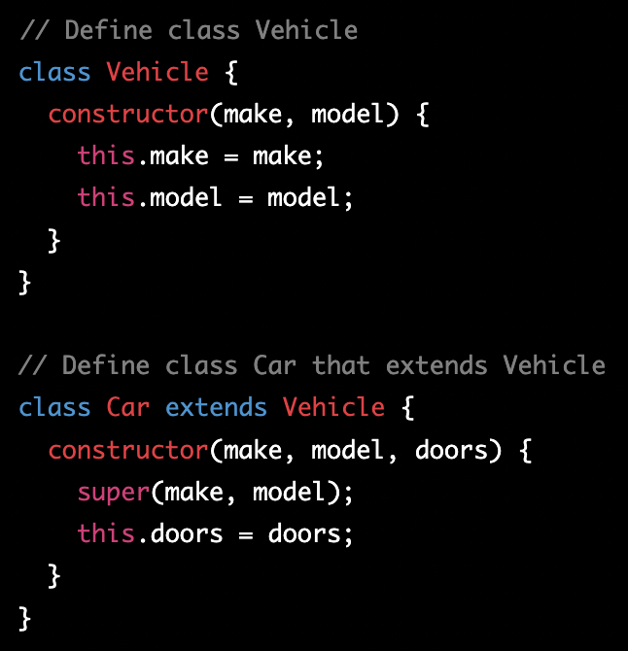
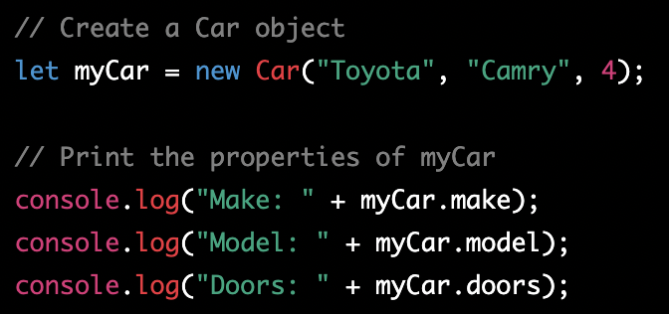
Classwork - extending and inheritance - solution§

Slide 21
Homework
Create a class called "Animal" with properties "species" and "age".
Add a method called "increaseAge" that increases the age of the animal by 1.
Create another class called "Dog" that extends "Animal" and adds a property called "breed".
Override the "increaseAge" method in the "Dog" class to also increase the "age" of the dog by 2.
Create a Dog object, increase its age multiple times and print the species, breed, and age of the dog.

